Slide 1
Minimum Spanning Tree

Slide 2
Problem: Laying Telephone Wire
Central office

Slide 3
Wiring: Naïve Approach
Central office
Expensive!

Slide 4
Wiring: Naive Approach
Central office
Minimize the total length of wire connecting the customers

Slide 5
Applications of MST
Any time you want to visit all vertices in a graph at minimum cost (e.g., wire routing on printed circuit boards, sewer pipe layout, road planning…)
Internet content distribution
  $$$, also a hot research topic
  Idea: publisher produces web pages, content distribution network replicates web pages to many locations so consumers can access at higher speed
  MST may not be good enough!
    content distribution on minimum cost tree may take a long time!
Provides a heuristic for traveling salesman problems.
The optimum traveling salesman tour is at most twice the length of the minimum spanning tree (why??)

Slide 6
Spanning Tree
A spanning tree of G is a subgraph which
  is a tree
  contains all vertices of G
How many edges are there in a spanning tree, if there are V vertices?

Slide 7
Spanning Trees
A spanning tree of a graph is just a subgraph that contains all the vertices and is a tree.
A graph may have many spanning trees.
Graph A
Some Spanning Trees from Graph A
or
or
or

Slide 8
All 16 of its Spanning Trees
Complete Graph

Slide 9
Minimum Spanning Trees
The Minimum Spanning Tree for a given graph is the Spanning Tree of minimum cost for that graph.
Complete Graph
Minimum Spanning Tree
7
2
2
5
3
3
4
1
1

Slide 10
Minimum Spanning Trees
Undirected, weighted graph G = (V,E)
Weight function W: E → ℜ
  (assigning cost or length or other values to edges)
Spanning tree: tree that connects all vertices
Minimum spanning tree (MST):
  spanning tree T that minimizes

Slide 11
Generic MST Algorithm
Generic-MST(G, w)
1 A := ∅ // Contains edges that belong to a MST
2 while A does not form a spanning tree do
3 Find an edge (u,v) that is safe for A
4 A := A ∪ {(u,v)}
5 return A
A safe edge is an edge that does not destroy A’s property.
MoreSpecific-MST(G, w)
1 A := ∅ // Contains edges that belong to a MST
2 while A does not form a spanning tree do
3.1 Make a cut (S, V-S) of G that respects A
3.2 Take the min-weight edge (u,v) connecting S to V-S
4 A := A ∪ {(u,v)}
5 return A

Slide 12
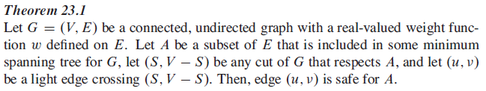
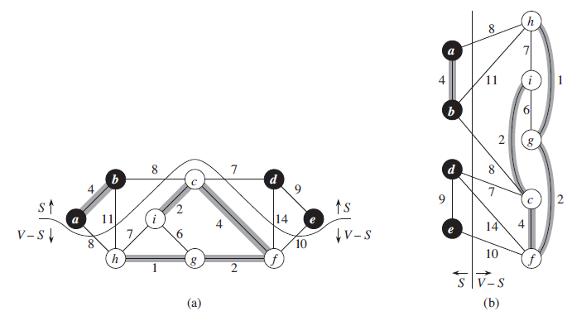
MST

Slide 13
Idea for an Algorithm
We have to make V–1 choices (edges of the MST) to arrive at the optimization goal.
After each choice we have a sub-problem that is one vertex smaller than the original problem.
  A dynamic programming algorithm would consider all possible choices (edges) at each vertex.
  Goal: at each vertex cheaply determine an edge that definitely belongs to an MST.

Slide 14
Greedy Choice
Greedy choice property: locally optimal (greedy) choice yields a globally optimal solution.
Theorem on Greedy choice for MST
  Let G=(V, E) and S ⊆ V
  S is a cut of G (it splits G into parts S and V-S)
  (u,v) is a light edge if it is a min-weight edge of G that connects S and V-S
  Then (u,v) belongs to a MST T of G.

Slide 15
...Greedy Choice
Proof
  Suppose (u,v) is light but (u,v) ∉ any MST
  look at path from u to v in some MST T
  Let (x, y) be the first edge on a path from u to v in T that crosses from S to V–S. Swap (x, y) with (u,v) in T.
  this improves cost of T ➔ contradiction (T is supposed to be an MST)
V-S
S
y
x
u
v

Slide 16
Algorithms for Obtaining the Minimum Spanning Tree
Prim's Algorithm
Kruskal's Algorithm
Boruvka's Algorithm

Slide 17
Prim-Jarnik Algorithm
Vertex based algorithm
Grows a single MST T one vertex at a time
The set A covers the portion of T that was already computed
Annotate all vertices v outside of the set A with v.key the minimum weight of an edge that connects v to a vertex in A
(v.key = ∞ if no such edge exists)

Slide 18
The steps are:
1. The new graph is constructed - with one node from the old graph.
2. While new graph has fewer than n nodes,
  1. Find the node from the old graph with the smallest connecting edge to the new graph,
  2. Add it to the new graph
Every step will have joined one node, so that at the end we will have one graph with all the nodes and it will be a minimum spanning tree of the original graph.

Slide 19
Prim’s algorithm
T = a spanning tree containing a single node s;
E = set of edges adjacent to s;
while T does not contain all the nodes {
  remove an edge (v, w) of lowest cost from E
  if w is already in T then discard edge (v, w)
  else {
    add edge (v, w) and node w to T
    add to E the edges adjacent to w
  }
}
An edge of lowest cost can be found with a priority queue
Testing for a cycle is automatic
  Hence, Prim’s algorithm is far simpler to implement than Kruskal’s algorithm

Slide 20
...Prim-Jarnik Algorithm
MST-Prim(G, s)
01 for each vertex u ∈ G.V
02 u.key := ∞
03 u.pred := NIL
04 s.key := 0
05 init(Q, G.V) // Q is a priority queue
06 while not isEmpty(Q)
07 u := extractMin(Q) // add u to T
08 for each v ∈ u.adj do
09 if v ∈ Q and w(u,v) < v.key then
v.key := w(u,v)
11 modifyKey(Q,v)
12 v.pred := u
updating keys

Slide 22
Complete Graph
B
4
C
4
2
1
A
4
E
1
F
D
2
3
10
G
5
5
6
3
4
I
H
2
3
J

Slide 23
Old Graph
New Graph
B
4
C
4
B
4
C
2
1
4
2
1
A
4
E
1
F
A
4
E
F
1
D
2
3
10
D
2
3
G
5
10
G
5
5
6
3
5
6
3
4
I
4
H
I
3
H
2
J
2
3
J

Slide 24
Old Graph
New Graph
B
4
C
4
B
4
C
2
1
4
2
1
A
4
E
1
F
A
4
E
F
1
D
2
3
10
D
2
3
G
5
10
G
5
5
6
3
5
6
3
4
I
4
H
I
3
H
2
J
2
3
J

Slide 25
Old Graph
New Graph
B
4
C
4
B
4
C
2
1
4
2
1
A
4
E
1
F
A
4
E
F
1
D
2
3
10
D
2
3
G
5
10
G
5
5
6
3
5
6
3
4
I
4
H
I
3
H
2
J
2
3
J

Slide 26
Old Graph
New Graph
B
4
C
4
B
4
C
2
1
4
2
1
A
4
E
1
F
A
4
E
F
1
D
2
3
10
D
2
3
G
5
10
G
5
5
6
3
5
6
3
4
I
4
H
I
3
H
2
J
2
3
J

Slide 27
Old Graph
New Graph
B
4
C
4
B
4
C
2
1
4
2
1
A
4
E
1
F
A
4
E
F
1
D
2
3
10
D
2
3
G
5
10
G
5
5
6
3
5
6
3
4
I
4
H
I
3
H
2
J
2
3
J

Slide 28
Old Graph
New Graph
B
4
C
4
B
4
C
2
1
4
2
1
A
4
E
1
F
A
4
E
F
1
D
2
3
10
D
2
3
G
5
10
G
5
5
6
3
5
6
3
4
I
4
H
I
3
H
2
J
2
3
J

Slide 29
Old Graph
New Graph
B
4
C
4
B
4
C
2
1
4
2
1
A
4
E
1
F
A
4
E
F
1
D
2
3
10
D
2
3
G
5
10
G
5
5
6
3
5
6
3
4
I
4
H
I
3
H
2
J
2
3
J

Slide 30
Old Graph
New Graph
B
4
C
4
B
4
C
2
1
4
2
1
A
4
E
1
F
A
4
E
F
1
D
2
3
10
D
2
3
G
5
10
G
5
5
6
3
5
6
3
4
I
4
H
I
3
H
2
J
2
3
J

Slide 31
Old Graph
New Graph
B
4
C
4
B
4
C
2
1
4
2
1
A
4
E
1
F
A
4
E
F
1
D
2
3
10
D
2
3
G
5
10
G
5
5
6
3
5
6
3
4
I
4
H
I
3
H
2
J
2
3
J

Slide 32
Old Graph
New Graph
B
4
C
4
B
4
C
2
1
4
2
1
A
4
E
1
F
A
4
E
F
1
D
2
3
10
D
2
3
G
5
10
G
5
5
6
3
5
6
3
4
I
4
H
I
3
H
2
J
2
3
J

Slide 33
Complete Graph
Minimum Spanning Tree
B
4
C
4
B
4
C
2
1
4
2
1
A
4
E
1
F
A
E
F
1
D
2
3
10
D
2
G
5
G
5
6
3
3
4
I
H
I
3
H
2
J
2
3
J

Slide 34
Walk-Through
Initialize array
2
 | K | d_{v} | p_{v}
A | F | ∞ | −
B | F | ∞ | −
C | F | ∞ | −
D | F | ∞ | −
E | F | ∞ | −
F | F | ∞ | −
G | F | ∞ | −
H | F | ∞ | −
F
3
C
10
A
7
3
8
4
4
B
18
D
9
10
H
2
25
3
G
E
7

Slide 35
Start with any node, say D
2
F
3
C
 | K | d_{v} | p_{v}
A
B
C
D | T | 0 | −
E
F
G
H
10
A
7
3
8
4
4
B
18
D
9
10
H
2
25
3
G
E
7

Slide 36
Update distances of adjacent, unselected nodes
2
F
3
C
 | K | d_{v} | p_{v}
A
B
C |  | 3 | D
D | T | 0 | −
E |  | 25 | D
F |  | 18 | D
G |  | 2 | D
H
10
A
7
3
8
4
4
B
18
D
9
10
H
2
25
3
G
E
7

Slide 37
2
Select node with minimum distance
F
3
C
 | K | d_{v} | p_{v}
A
B
C |  | 3 | D
D | T | 0 | −
E |  | 25 | D
F |  | 18 | D
G | T | 2 | D
H
10
A
7
3
8
4
4
B
18
D
9
10
H
2
25
3
G
E
7

Slide 38
Update distances of adjacent, unselected nodes
2
F
3
C
 | K | d_{v} | p_{v}
A
B
C |  | 3 | D
D | T | 0 | −
E |  | 7 | G
F |  | 18 | D
G | T | 2 | D
H |  | 3 | G
10
A
7
3
8
4
4
B
18
D
9
10
H
2
25
3
G
E
7

Slide 39
Select node with minimum distance
2
F
3
C
 | K | d_{v} | p_{v}
A
B
C | T | 3 | D
D | T | 0 | −
E |  | 7 | G
F |  | 18 | D
G | T | 2 | D
H |  | 3 | G
10
A
7
3
8
4
4
B
18
D
9
10
H
2
25
3
G
E
7

Slide 40
Update distances of adjacent, unselected nodes
2
F
3
C
 | K | d_{v} | p_{v}
A
B |  | 4 | C
C | T | 3 | D
D | T | 0 | −
E |  | 7 | G
F |  | 3 | C
G | T | 2 | D
H |  | 3 | G
10
A
7
3
8
4
4
B
18
D
9
10
H
2
25
3
G
E
7

Slide 41
Select node with minimum distance
2
F
3
C
 | K | d_{v} | p_{v}
A
B |  | 4 | C
C | T | 3 | D
D | T | 0 | −
E |  | 7 | G
F | T | 3 | C
G | T | 2 | D
H |  | 3 | G
10
A
7
3
8
4
4
B
18
D
9
10
H
2
25
3
G
E
7

Slide 42
Update distances of adjacent, unselected nodes
2
F
3
C
 | K | d_{v} | p_{v}
A |  | 10 | F
B |  | 4 | C
C | T | 3 | D
D | T | 0 | −
E |  | 2 | F
F | T | 3 | C
G | T | 2 | D
H |  | 3 | G
10
A
7
3
8
4
4
B
18
D
9
10
H
2
25
3
G
E
7

Slide 43
2
Select node with minimum distance
F
3
C
 | K | d_{v} | p_{v}
A |  | 10 | F
B |  | 4 | C
C | T | 3 | D
D | T | 0 | −
E | T | 2 | F
F | T | 3 | C
G | T | 2 | D
H |  | 3 | G
10
A
7
3
8
4
4
B
18
D
9
10
H
2
25
3
G
E
7

Slide 44
Update distances of adjacent, unselected nodes
2
F
3
C
 | K | d_{v} | p_{v}
A |  | 10 | F
B |  | 4 | C
C | T | 3 | D
D | T | 0 | −
E | T | 2 | F
F | T | 3 | C
G | T | 2 | D
H |  | 3 | G
10
A
7
3
8
4
4
B
18
D
9
10
H
2
25
3
G
E
7
Table entries unchanged

Slide 45
Select node with minimum distance
2
F
3
C
 | K | d_{v} | p_{v}
A |  | 10 | F
B |  | 4 | C
C | T | 3 | D
D | T | 0 | −
E | T | 2 | F
F | T | 3 | C
G | T | 2 | D
H | T | 3 | G
10
A
7
3
8
4
4
B
18
D
9
10
H
2
25
3
G
E
7

Slide 46
Update distances of adjacent, unselected nodes
2
F
3
C
 | K | d_{v} | p_{v}
A |  | 4 | H
B |  | 4 | C
C | T | 3 | D
D | T | 0 | −
E | T | 2 | F
F | T | 3 | C
G | T | 2 | D
H | T | 3 | G
10
A
7
3
8
4
4
B
18
D
9
10
H
2
25
3
G
E
7

Slide 47
Select node with minimum distance
2
F
3
C
 | K | d_{v} | p_{v}
A | T | 4 | H
B |  | 4 | C
C | T | 3 | D
D | T | 0 | −
E | T | 2 | F
F | T | 3 | C
G | T | 2 | D
H | T | 3 | G
10
A
7
3
8
4
4
B
18
D
9
10
H
2
25
3
G
E
7

Slide 48
Update distances of adjacent, unselected nodes
2
F
3
C
 | K | d_{v} | p_{v}
A | T | 4 | H
B |  | 4 | C
C | T | 3 | D
D | T | 0 | −
E | T | 2 | F
F | T | 3 | C
G | T | 2 | D
H | T | 3 | G
10
A
7
3
8
4
4
B
18
D
9
10
H
2
25
3
G
E
7
Table entries unchanged

Slide 49
Select node with minimum distance
2
F
3
C
 | K | d_{v} | p_{v}
A | T | 4 | H
B | T | 4 | C
C | T | 3 | D
D | T | 0 | −
E | T | 2 | F
F | T | 3 | C
G | T | 2 | D
H | T | 3 | G
10
A
7
3
8
4
4
B
18
D
9
10
H
2
25
3
G
E
7

Slide 50
Cost of Minimum Spanning Tree = Σ d_{v} = 21
2
F
3
C
 | K | d_{v} | p_{v}
A | T | 4 | H
B | T | 4 | C
C | T | 3 | D
D | T | 0 | −
E | T | 2 | F
F | T | 3 | C
G | T | 2 | D
H | T | 3 | G
A
3
4
4
B
D
H
2
3
G
E
Done

Slide 51
Implementation Issues
MST-Prim(G,r)
01 for each vertex u ∈ G.V
02 u.key := ∞
03 u.parent := NIL
04 r.key := 0
05 init(Q, G.V) // Q is a priority queue
06 while not isEmpty(Q)
07 u := extractMin(Q) // add u to T
08 for each v ∈ u.adj do
09 if v ∈ Q and w(u,v) < v.key then
v.key := w(u,v)
11 modifyKey(Q,v)
12 v.parent := u

Slide 52
Priority Queues
A priority queue maintains a set S of elements, each with an associated key value.
We need PQ to support the following operations
  init( Q: PriorityQueue, S: VertexSet)
  extractMin( Q: PriorityQueue): Vertex
  modifyKey( Q: PriorityQueue, v: Vertex)
To choose how to implement a PQ, we need to count how many times the operations are performed:
  init is performed just once and runs in O(n)

Slide 53
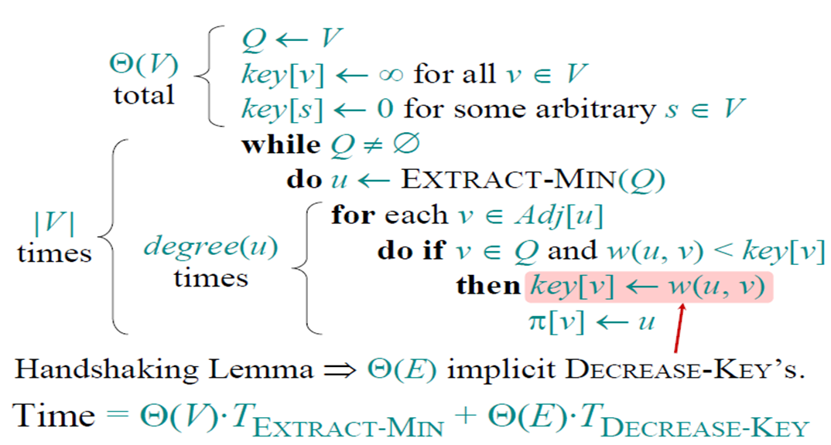
Analysis of Prim's Algorithm

Slide 54
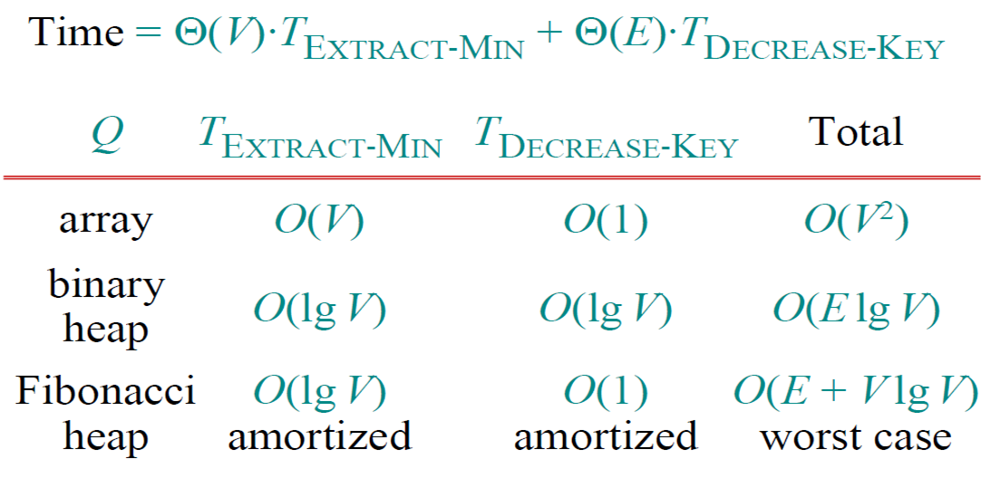
Analysis of Prim's Algorithm

Slide 55
Prim-Jarnik’s Running Time
Time = |V|*T(extractMin) + O(E)*T(modifyKey)
E ≥ V-1, E < V², E = O(V²)
Binary heap implementation:
  Time = O(V logV + E logV) = O(V² logV) = O(E logV)
Q | T(extractMin) | T(modifyKey) | Total
array | O(V) | O(1) | O(V²)
binary heap | O(log V) | O(log V) | O(E logV)

Slide 56
MST Exercise
B
5
C
3
4
8
6
8
A
F
D
7
5
4
2
E

Slide 57
Kruskal's Algorithm
Edge based algorithm
Add edges one at a time in increasing weight order.
The algorithm maintains A: a forest of trees.
An edge is accepted if it connects vertices of distinct trees (the cut respects A)

Slide 58
The steps are:
1. The forest is constructed - with each node in a separate tree.
2. The edges are placed in a priority queue.
3. Until we've added n-1 edges,
1. Extract the cheapest edge from the queue,
2. If it forms a cycle, reject it,
3. Else add it to the forest. Adding it to the forest will join two trees together.
Every step will have joined two trees in the forest together, so that at the end, there will only be one tree in T.

Slide 59
Kruskal’s algorithm
Finding an edge of lowest cost can be done just by sorting the edges Efficient testing for a cycle requires a fairly complex algorithm (UNION-FIND) which we don’t cover in this course
T = empty spanning tree;
E = set of edges;
N = number of nodes in graph;
while T has fewer than N - 1 edges {
  remove an edge (v, w) of lowest cost from E
  if adding (v, w) to T would create a cycle
    then discard (v, w)
    else add (v, w) to T
}

Slide 60
Kruskal's Algorithm
The algorithm keeps adding the cheapest edge that connects two trees of the forest
MST-Kruskal(G)
01 A := ∅
02 init(S) // Init disjoint-set
03 for each vertex v ∈ G.V
04 addSingletonSet(S,v)
05 sort the edges of G.E by non-decreasing w(u,v)
06 for each edge (u,v) ∈ E in sorted order do
07 if findSet(S,u) ≠ findSet(S,v) then
08 A := A ∪ {(u,v)}
09 unionSets(S,u,v)
10 return A

Slide 61
Complete Graph
B
4
C
4
2
1
A
4
E
1
F
D
2
3
10
G
5
5
6
3
4
I
H
2
3
J

Slide 62
A
4
B
A
1
D
B
4
C
B
4
D
B
4
C
B
10
J
C
2
E
4
2
1
C
1
F
D
5
H
A
4
E
1
F
2
D
6
J
E
2
G
D
3
10
G
5
F
3
G
F
5
I
5
6
3
4
I
G
3
I
G
4
J
H
2
3
J
H
2
J
I
3
J

Slide 63
Sort Edges
(in reality they are placed in a priority queue - not sorted - but sorting them makes the algorithm easier to visualize)
1
1
A
D
C
F
C
2
E
E
2
G
B
4
C
H
2
J
F
3
G
4
2
1
G
3
I
I
3
J
A
4
E
1
F
2
A
4
B
B
4
D
D
3
10
G
5
B
4
C
G
4
J
5
6
3
4
I
F
5
I
D
5
H
H
2
3
J
D
6
J
B
10
J

Slide 64
Add Edge
1
1
A
D
C
F
C
2
E
E
2
G
B
4
C
H
2
J
F
3
G
4
2
1
G
3
I
I
3
J
A
4
E
1
F
2
A
4
B
B
4
D
D
3
10
G
5
B
4
C
G
4
J
5
6
3
4
I
F
5
I
D
5
H
H
2
3
J
D
6
J
B
10
J

Slide 65
Add Edge
1
1
A
D
C
F
C
2
E
E
2
G
B
4
C
H
2
J
F
3
G
4
2
1
G
3
I
I
3
J
A
4
E
1
F
2
A
4
B
B
4
D
D
3
10
G
5
B
4
C
G
4
J
5
6
3
4
I
F
5
I
D
5
H
H
2
3
J
D
6
J
B
10
J

Slide 66
Add Edge
1
1
A
D
C
F
C
2
E
E
2
G
B
4
C
H
2
J
F
3
G
4
2
1
G
3
I
I
3
J
A
4
E
1
F
2
A
4
B
B
4
D
D
3
10
G
5
B
4
C
G
4
J
5
6
3
4
I
F
5
I
D
5
H
H
2
3
J
D
6
J
B
10
J

Slide 67
Add Edge
1
1
A
D
C
F
C
2
E
E
2
G
B
4
C
H
2
J
F
3
G
4
2
1
G
3
I
I
3
J
A
4
E
1
F
2
A
4
B
B
4
D
D
3
10
G
5
B
4
C
G
4
J
5
6
3
4
I
F
5
I
D
5
H
H
2
3
J
D
6
J
B
10
J

Slide 68
Add Edge
1
1
A
D
C
F
C
2
E
E
2
G
B
4
C
H
2
J
F
3
G
4
2
1
G
3
I
I
3
J
A
4
E
1
F
2
A
4
B
B
4
D
D
3
10
G
5
B
4
C
G
4
J
5
6
3
4
I
F
5
I
D
5
H
H
2
3
J
D
6
J
B
10
J

Slide 69
Cycle
Don’t Add Edge
1
1
A
D
C
F
C
2
E
E
2
G
B
4
C
H
2
J
F
3
G
4
2
1
G
3
I
I
3
J
A
4
E
1
F
2
A
4
B
B
4
D
D
3
10
G
5
B
4
C
G
4
J
5
6
3
4
I
F
5
I
D
5
H
H
2
3
J
D
6
J
B
10
J

Slide 70
Add Edge
1
1
A
D
C
F
C
2
E
E
2
G
B
4
C
H
2
J
F
3
G
4
2
1
G
3
I
I
3
J
A
4
E
1
F
2
A
4
B
B
4
D
D
3
10
G
5
B
4
C
G
4
J
5
6
3
4
I
F
5
I
D
5
H
H
2
3
J
D
6
J
B
10
J

Slide 71
Add Edge
1
1
A
D
C
F
C
2
E
E
2
G
B
4
C
H
2
J
F
3
G
4
2
1
G
3
I
I
3
J
A
4
E
1
F
2
A
4
B
B
4
D
D
3
10
G
5
B
4
C
G
4
J
5
6
3
4
I
F
5
I
D
5
H
H
2
3
J
D
6
J
B
10
J

Slide 72
Add Edge
1
1
A
D
C
F
C
2
E
E
2
G
B
4
C
H
2
J
F
3
G
4
2
1
G
3
I
I
3
J
A
4
E
1
F
2
A
4
B
B
4
D
D
3
10
G
5
B
4
C
G
4
J
5
6
3
4
I
F
5
I
D
5
H
H
2
3
J
D
6
J
B
10
J

Slide 73
Cycle
Don’t Add Edge
1
1
A
D
C
F
C
2
E
E
2
G
B
4
C
H
2
J
F
3
G
4
2
1
G
3
I
I
3
J
A
4
E
1
F
2
A
4
B
B
4
D
D
3
10
G
5
B
4
C
G
4
J
5
6
3
4
I
F
5
I
D
5
H
H
2
3
J
D
6
J
B
10
J

Slide 74
Add Edge
1
1
A
D
C
F
C
2
E
E
2
G
B
4
C
H
2
J
F
3
G
4
2
1
G
3
I
I
3
J
A
4
E
1
F
2
A
4
B
B
4
D
D
3
10
G
5
B
4
C
G
4
J
5
6
3
4
I
F
5
I
D
5
H
H
2
3
J
D
6
J
B
10
J

Slide 75
Minimum Spanning Tree
Complete Graph
B
4
C
4
B
C
4
4
2
1
2
1
A
E
A
4
1
F
E
F
1
D
2
2
D
3
10
G
G
5
3
5
6
3
4
I
I
H
H
2
3
3
J
2
J

Slide 76
Walk Through
8
6
D
B
C
4
A
3
4
13
9
12
6
I
8
H
10
5
F
E
3
1
G
S = { A, B, C, D, E, F, G, H, I }
E’ = { HG-1, CI-3, GF-3, CF-4, AB-4, HI-6, CD-6, BC-8, AH-8, DE-9, EF-10, BH-12, DF-13 }
S = { A, B, C, D, E, F, G, H, I }
E’ = { HG-1, CI-3, GF-3, CF-4, AB-4, HI-6, CD-6, BC-8, AH-8, DE-9, EF-10, BH-12, DF-13 }

Slide 77
Walk Through
8
6
D
B
C
4
A
3
4
13
9
12
6
I
8
H
10
5
F
E
3
1
G
S = { A, B, C, D, E, F, GH, I }
E’ = { CI-3, GF-3, CF-4, AB-4, HI-6, CD-6, BC-8, AH-8, DE-9, EF-10, BH-12, DF-13 }

Slide 78
Walk Through
8
6
D
B
C
4
A
3
4
13
9
12
6
I
8
H
10
5
F
E
3
1
G
S = { A, B, CI, D, E, F, GH }
E’ = { GF-3, CF-4, AB-4, HI-6, CD-6, BC-8, AH-8, DE-9, EF-10, BH-12, DF-13 }

Slide 79
Walk Through
8
6
D
B
C
4
A
3
4
13
9
12
6
I
8
H
10
5
F
E
3
1
G
S = { A, B, CI, D, E, FGH }
E’ = { CF-4, AB-4, HI-6, CD-6, BC-8, AH-8, DE-9, EF-10, BH-12, DF-13 }

Slide 80
Walk Through
8
6
D
B
C
4
A
3
4
13
9
12
6
I
8
H
10
5
F
E
3
1
G
S = { A, B, CFGHI, D, E }
E’ = { AB-4, HI-6, CD-6, BC-8, AH-8, DE-9, EF-10, BH-12, DF-13 }

Slide 81
Walk Through
8
6
D
B
C
4
A
3
4
13
9
12
6
I
8
H
10
5
F
E
3
1
G
S = { AB, CFGHI, D, E }
E’ = { HI-6, CD-6, BC-8, AH-8, DE-9, EF-10, BH-12, DF-13 }

Slide 82
Walk Through
8
6
D
B
C
4
A
3
4
13
9
12
6
I
8
H
10
5
F
E
3
1
G
S = { AB, CDFGHI, E }
E’ = { BC-8, AH-8, DE-9, EF-10, BH-12, DF-13 }

Slide 83
Walk Through
8
6
D
B
C
4
A
3
4
13
9
12
6
I
8
H
10
5
F
E
3
1
G
S = { ABCDFGHI, E }
E’ = { AH-8, DE-9, EF-10, BH-12, DF-13 }

Slide 84
Walk Through
8
6
D
B
C
4
A
3
4
13
9
12
6
I
8
H
10
5
F
E
3
1
G
S = { ABCDEFGHI }
E’ = { EF-10, BH-12, DF-13 }

Slide 85
Walk Through
8
6
D
B
C
4
A
3
4
9
I
H
E
3
F
1
G
S = { ABCDEFGHI }
E’ = { HG-1, CI-3, GF-3, CF-4, AB-4, CD-6, BC-8, DE-9 }; Total Cost := 38

Slide 86
Implementation Factors: Disjoint Sets
We need to maintain a disjoint partitioning of a set, i.e., a collection S of disjoint sets. Operations:
  addSingeltonSet(S:Set, x:Vertex)
    S := S ∪ {{x}}
  findSet(S:Set, x:Vertex): Set
    returns X ∈ S such that x ∈ X
  unionSets(S:Set, x:Vertex, y:Vertex)
    X := findSet(S:Set, x)
    Y := findSet(S:Set, y)
    S := S – {X, Y} ∪ {X ∪ Y}

Slide 87
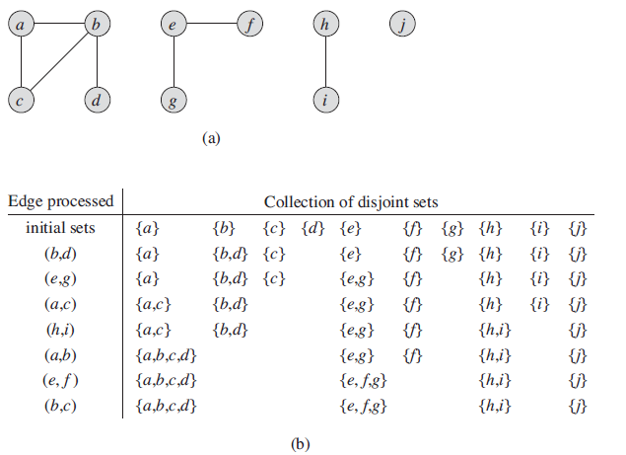
Disjoint Sets

Slide 88
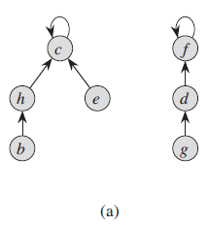
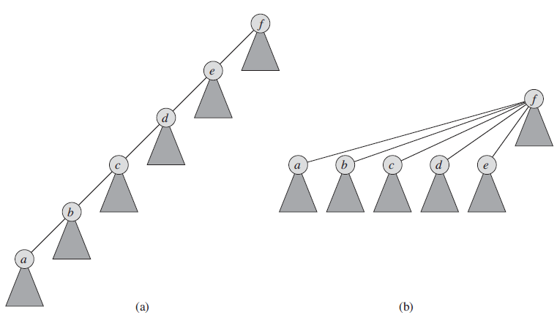
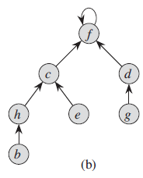
Disjoint-set forests

Slide 89
Implementation Factors: Disjoint Sets as Lists
Each set is a list of elements identified by the first element, all elements in the list point to the first element
UnionSets: add a shorter list to a longer one, O(min{|C(u)|, |C(v)|})
MakeSet/FindSet: O(1)
1
2
3
4
A
B
C
∅
∅
1
2
3
4
A
B
C
∅

Slide 90
Kruskal Running Time
Initialization O(V) time
Sorting the edges Θ(E log E) = Θ(E log V)
O(E) calls to FindSet
Union costs
  Let t(v) be the number of times v is moved to a new cluster
  Each time a vertex is moved to a new cluster the size of the cluster containing the vertex at least doubles: t(v) ≤ log V
  Total time spent doing Union
Total time: O(E log V)

Slide 91
MST Exercise
B
5
C
3
4
8
6
8
A
F
D
7
5
4
2
E

Slide 92
Boruvka's Algorithm
This algorithm is similar to Prim’s, but nodes are added to the new graph in parallel all around the graph.
It creates a list of trees, each containing one node from the original graph and proceeds to merge them along the smallest-weight connecting edges until there’s only one tree, which is, of course, the MST.
It works rather like a merge sort.

Slide 93
The steps are
1. Make a list of n trees, each containing a single node
2. While list has more than one tree,
1. For each tree in the list, find the node not connected to the tree with the smallest connecting edge to that tree,
2. Add all the edges found to the new graph, thus creating a new set of trees
Every step will have joined groups of trees, until only one tree remains.

Slide 94
Complete Graph
B
4
C
4
2
1
A
4
E
1
F
D
2
3
10
G
5
5
6
3
4
I
H
2
3
J

Slide 95
Boruvka's Example
List of Trees
Trees of the Graph at Beginning of Round 1
4
A
B
C
D
E
F
G
H
I
J
B
C
4
2
1
A
4
E
1
F
D
2
3
10
G
5
5
6
3
4
I
H
2
3
J

Slide 96
Round 1
Tree A
B
4
C
B
4
4
2
1
A
4
E
A
1
F
1
D
2
3
D
10
G
5
5
6
3
4
I
H
2
3
J

Slide 97
Round 1
Edge A-D
B
4
C
B
4
4
2
1
A
4
E
A
1
F
1
D
2
3
D
10
G
5
5
6
3
4
I
H
2
3
J

Slide 98
Round 1
Tree B
B
4
C
4
B
C
4
4
2
1
A
4
E
A
4
1
F
D
2
3
D
10
10
G
5
5
6
3
4
I
H
2
3
J
J

Slide 99
Round 1
Edge B-A
B
4
C
4
B
C
4
4
2
1
A
4
E
A
4
1
F
D
2
3
D
10
10
G
5
5
6
3
4
I
H
2
3
J
J

Slide 100
Round 1
Tree C
B
4
C
4
B
C
4
2
1
2
1
A
4
E
1
F
E
F
D
2
3
10
G
5
5
6
3
4
I
H
2
3
J

Slide 101
Round 1
Edge C-F
B
4
C
4
B
C
4
2
1
2
1
A
4
E
1
F
E
F
D
2
3
10
G
5
5
6
3
4
I
H
2
3
J

Slide 102
Round 1
Tree D
B
4
C
B
4
2
1
A
4
E
A
4
1
F
1
D
2
3
D
10
G
5
5
6
3
5
6
4
I
H
H
2
3
J
J

Slide 103
Round 1
Edge D-A
B
4
C
B
4
2
1
A
4
E
A
4
1
F
1
D
2
3
D
10
G
5
5
6
3
5
6
4
I
H
H
2
3
J
J

Slide 104
Round 1
Tree E
B
4
C
C
4
2
1
2
A
4
E
1
F
E
D
2
3
2
10
G
5
G
5
6
3
4
I
H
2
3
J

Slide 105
Round 1
Edge E-C
B
4
C
C
4
2
1
2
A
4
E
1
F
E
D
2
3
2
10
G
5
G
5
6
3
4
I
H
2
3
J

Slide 106
Round 1
Tree F
B
4
C
C
4
2
1
1
A
4
E
1
F
F
D
2
3
3
10
G
5
5
G
5
6
3
4
I
I
H
2
3
J

Slide 107
Round 1
Edge F-C
B
4
C
C
4
2
1
1
A
4
E
1
F
F
D
2
3
3
10
G
5
5
G
5
6
3
4
I
I
H
2
3
J

Slide 108
Round 1
Tree G
B
4
C
4
2
1
A
4
E
1
F
E
F
D
2
3
2
3
10
G
5
G
5
6
3
3
4
4
I
I
H
2
3
J
J

Slide 109
Round 1
Edge G-E
B
4
C
4
2
1
A
4
E
1
F
E
F
D
2
3
2
3
10
G
5
G
5
6
3
3
4
4
I
I
H
2
3
J
J

Slide 110
Round 1
Tree H
B
4
C
4
2
1
A
4
E
1
F
D
2
3
D
10
G
5
5
6
3
5
4
I
H
H
2
3
J
2
J

Slide 111
Round 1
Edge H-J
B
4
C
4
2
1
A
4
E
1
F
D
2
3
D
10
G
5
5
6
3
5
4
I
H
H
2
3
J
2
J

Slide 112
Round 1
Tree I
B
4
C
4
2
1
A
4
E
1
F
F
D
2
3
10
G
5
5
G
5
6
3
3
4
I
I
H
2
3
3
J
J

Slide 113
Round 1
Edge I-G
B
4
C
4
2
1
A
4
E
1
F
F
D
2
3
10
G
5
5
G
5
6
3
3
4
I
I
H
2
3
3
J
J

Slide 114
Round 1
Tree J
B
4
C
B
4
2
1
A
4
E
1
F
D
2
3
D
10
10
G
5
G
5
6
3
6
4
4
I
I
H
H
2
3
3
J
2
J

Slide 115
Round 1
Edge J-H
B
4
C
B
4
2
1
A
4
E
1
F
D
2
3
D
10
10
G
5
G
5
6
3
6
4
4
I
I
H
H
2
3
3
J
2
J

Slide 116
Round 1 Ends - Add Edges
List of Edges to Add
4
A-D
B-A
C-F
D-A
E-C
F-C
G-E
H-J
I-G
J-H
B
C
4
2
1
A
4
E
1
F
D
2
3
10
G
5
5
6
3
4
I
H
2
3
J

Slide 117
Trees of the Graph at Beginning of Round 2
List of Trees
4
D-A-B
F-C-E-G-I
H-J
B
C
4
2
1
A
4
E
1
F
D
2
3
10
G
5
5
6
3
4
I
H
2
3
J

Slide 118
Round 2
Tree D-A-B
B
4
C
4
B
C
4
4
2
1
2
1
A
4
E
A
4
1
F
E
F
1
D
2
3
2
D
10
10
G
5
G
5
6
3
5
6
3
4
I
I
H
H
2
3
J
2
J

Slide 119
Round 2
Edge B-C
B
4
C
4
B
C
4
4
2
1
2
1
A
4
E
A
4
1
F
E
F
1
D
2
3
2
D
10
10
G
5
G
5
6
3
5
6
3
4
I
I
H
H
2
3
J
2
J

Slide 120
Round 2
Tree F-C-E-G-I
B
4
C
4
B
C
4
4
2
1
2
1
A
4
E
A
1
F
E
F
1
D
2
3
2
D
3
10
G
5
5
G
5
6
3
3
4
4
I
I
H
H
2
3
3
J
2
J

Slide 121
Round 2
Edge I-J
B
4
C
4
B
C
4
4
2
1
2
1
A
4
E
A
1
F
E
F
1
D
2
3
2
D
3
10
G
5
5
G
5
6
3
3
4
4
I
I
H
H
2
3
3
J
2
J

Slide 122
Round 2
Tree H-J
B
4
C
B
C
4
4
2
1
2
1
A
4
E
A
1
F
E
F
1
D
2
3
2
D
10
10
G
5
G
5
6
3
5
6
3
4
4
I
I
H
H
2
3
3
J
2
J

Slide 123
Round 2
Edge J-I
B
4
C
B
C
4
4
2
1
2
1
A
4
E
A
1
F
E
F
1
D
2
3
2
D
10
10
G
5
G
5
6
3
5
6
3
4
4
I
I
H
H
2
3
3
J
2
J

Slide 124
Round 2 Ends - Add Edges
List of Edges to Add
4
B-C
I-J
J-I
B
C
4
2
1
A
4
E
1
F
D
2
3
10
G
5
5
6
3
4
I
H
2
3
J

Slide 125
Minimum Spanning Tree
Complete Graph
B
4
C
4
B
C
4
4
2
1
2
1
A
E
A
4
1
F
E
F
1
D
2
2
D
3
10
G
G
5
3
5
6
3
4
I
I
H
H
2
3
3
J
2
J

Slide 126
Analysis of Boruvka's Algorithm
Running Time = O(m log n) (m = edges, n = nodes)
Although this algorithm is difficult to explain, unlike the two preceding algorithms, it does not require a complicated data structure.
Like Prim’s, it does not need to worry about detecting cycles. It does, however, need to see the whole graph, but it only examines pieces of it at a time, not all of it at once.
Like Kruskal’s it is best if edges are kept to a minimum (though it doesn’t hurt to keep the nodes to a minimum as well).

Slide 127
Conclusion
Kruskal’s and Boruvka’s have better running times if the number of edges is low, while Prim’s has a better running time if both the number of edges and the number of nodes are low.
Boruvka’s avoids the complicated data structures needed for the other two algorithms.
So, of course, the best algorithm depends on the graph and if you want to bear the cost of complex data structures.
The best algorithm that I know of is a hybrid of Boruvka’s and Prim’s, which I did not examine here. It does O(log log n) passes of Boruvka’s and then switches to Prim’s, resulting in a running time of O(m log log n). So, it’s the fastest algorithm, but would, of course, require the Fibonacci heap for Prim’s which Boruvka’s avoids when used by itself. However, in order to keep things simple, I did not explore it here.

